Slide 1

JAN-SWASTHYA
- PHASE-2 PROJECT PRESENTATION

Slide 2


Implementation:
→WEB APPLICATION:
Tools Used
Functionality
User Interaction
Preface:
What is Pneumonia?
Data Set
Necessary Libraries Used
LIVE DEMO

Slide 3

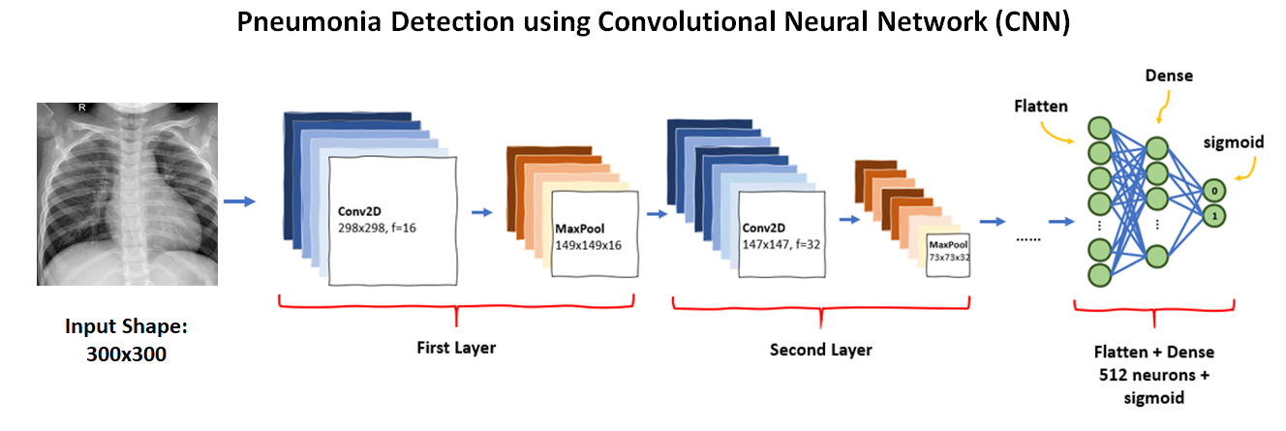
→MODEL DEVELOPMENT:
Layers(Con2D,MaxPooling2D,Flatten,Dense)
Specifications(loss,Optimizer,Metrics)
MODEL TRAINING:
ImageDataGenerator
Normalization
Generators
Epochs

Slide 4
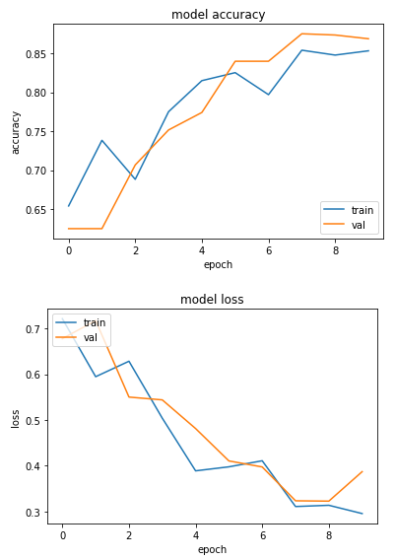
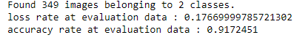
TESTING:
→MODEL EVALUATION:
Test Data set
Validate Assumptions(algorithm’s Used)
Loss, Accuracy Calculated

Slide 5

RESULTS & DISCUSSIONS

Slide 6
CONCLUSION & FUTURE ENHANCEMENTS
Throughout the process of developing the CNN model for Pneumonia prediction, we have built a model from scratch which consists of 5 layers and follows with a fully connected neural network. Then the trained model is evaluated using separate unseen data to avoid bias prediction. As the result, the accuracy of the test dataset is expected above 80% which indicates a decent model. This mini-project allows a beginner to obtain an overview of how to build a model to solve a real-world problem.
It is no doubt that the predictive model can be improved even better by performing data augmentation or implementing a transfer learning concept which facilitates the model a room for improvement. Therefore, this will be added as further enhancement in the upcoming stories.

Slide 7

Thank You!
Team Members:
Maneesh Reddy-18BTRCI019
Sarayu – 18BTRCI036
Krishna Mohan – 18BTRCI047
Shahanawaz Shaik – 18BTRCI062

